Slide 1


Trends & Insights: Airbnb Analysis in Santa Clara County
Presented by:-
Rohit Dhole
Mansi Tanna
Lovely Priya
Apurva Muchandi
Aashima Taneja

Slide 2

Introduction and Objective
Why Airbnb data?
Why Santa Clara County?
Objective:
Identify trends in pricing, occupancy, and availability.
Highlight popular neighborhoods.
Investigate factors influencing pricing (e.g., amenities, location).
Data Overview
Source: Inside Airbnb
Dataset Summary: listing ID, neighborhood, price, room type, availability, reviews, and rating.
Tools Used: Python, Power BI etc

Slide 3
Impact
Helps hosts optimize pricing strategies and improve occupancy.
Travelers gain insights on affordable areas and Superhost benefits.
Supports local businesses and planners in aligning with market demand.

Slide 4


Slide 5
Neighbourhood Analysis

Slide 6
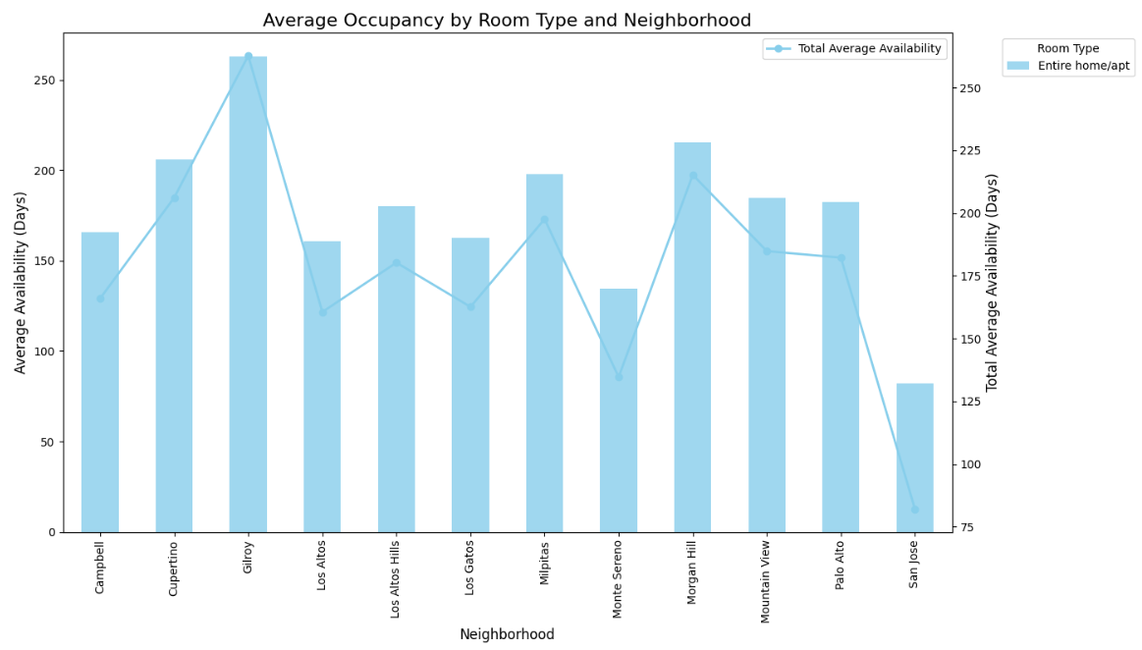
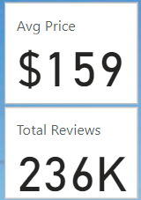
Avg Occupancy by Room Type & Neighbourhood

Slide 7
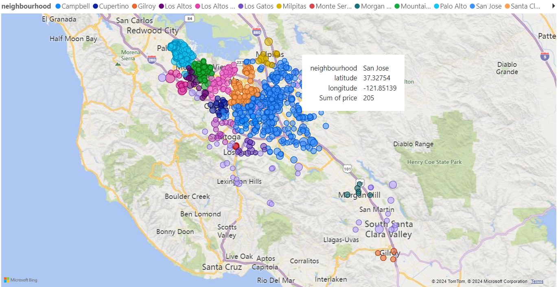
Prices in Each Neighbourhood

Slide 8
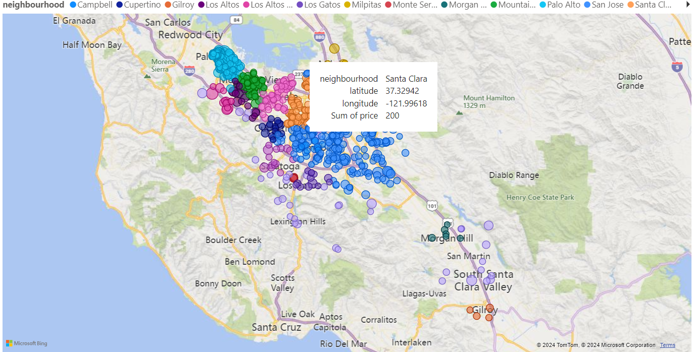
Prices in Each Neighbourhood

Slide 9
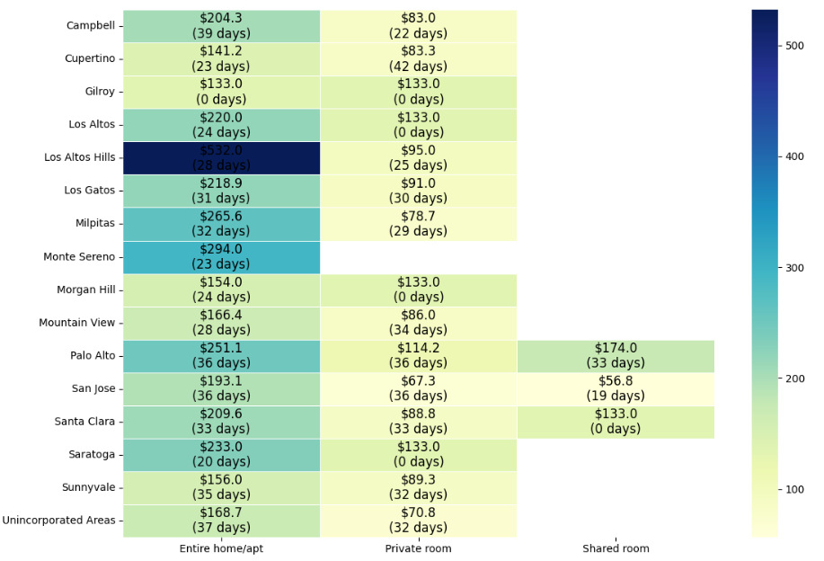
Avg Prices & Availability by Neighbourhood

Slide 10
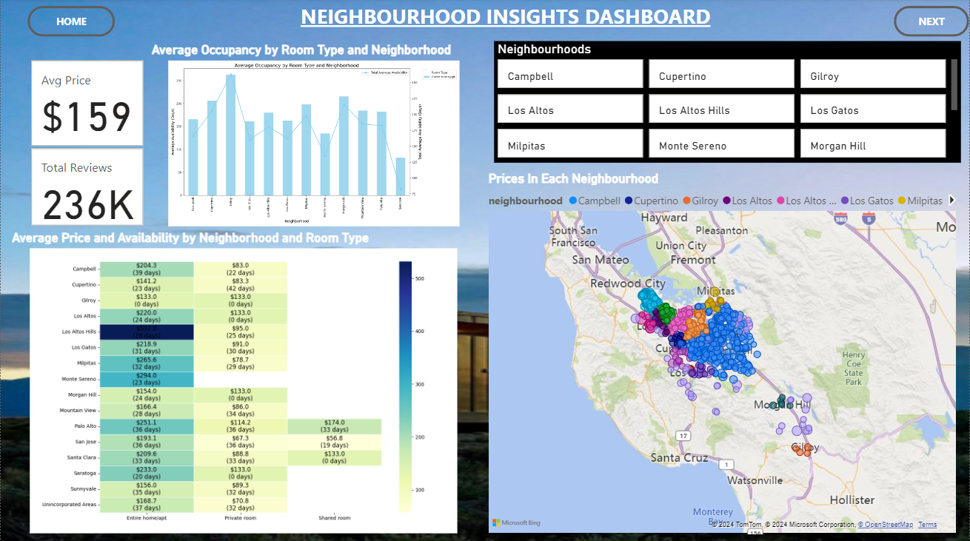
Dashboard

Slide 11
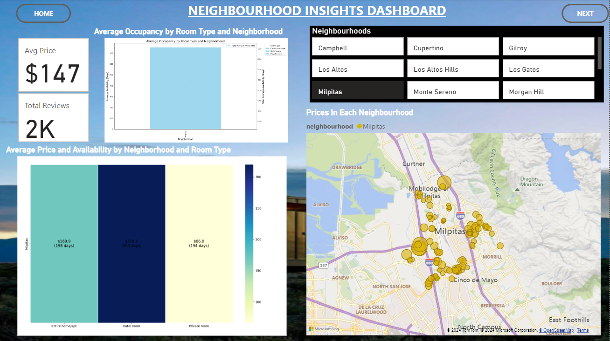
Dashboard

Slide 12
Host Analysis

Slide 13
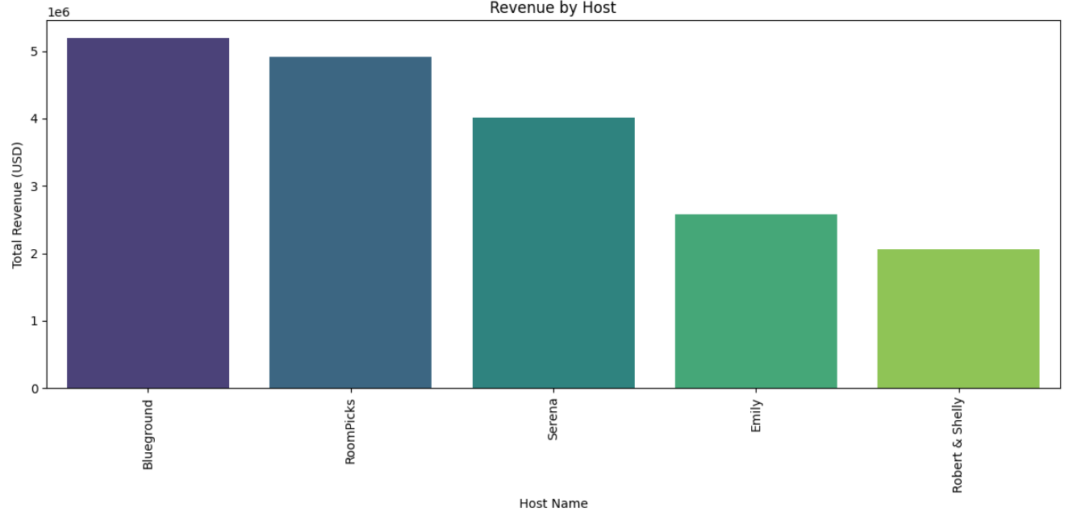
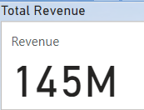
Revenue by Host

Slide 14
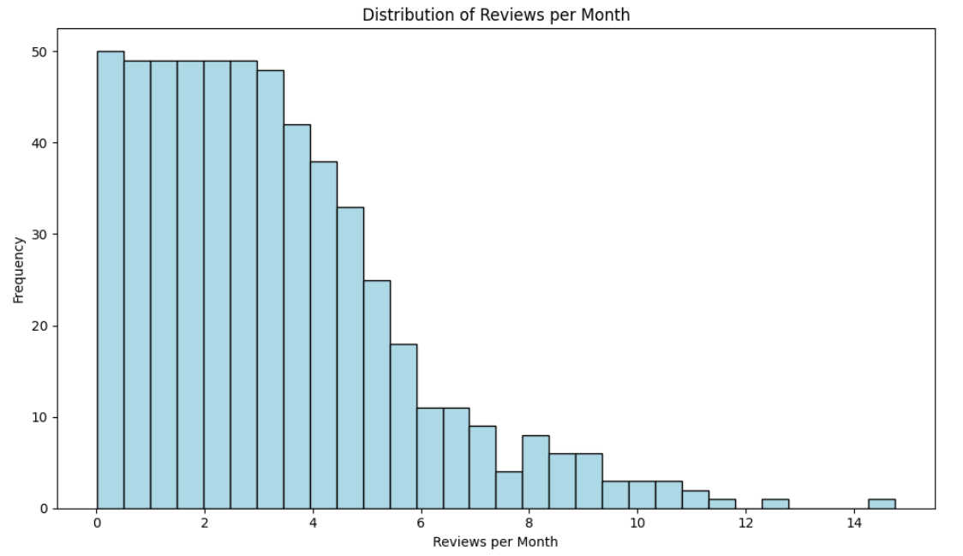
Reviews per Month

Slide 15
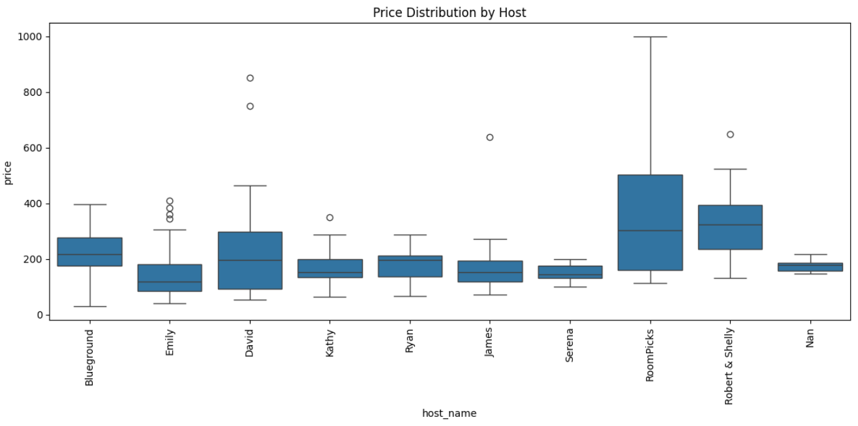
Price Distribution by Host

Slide 16
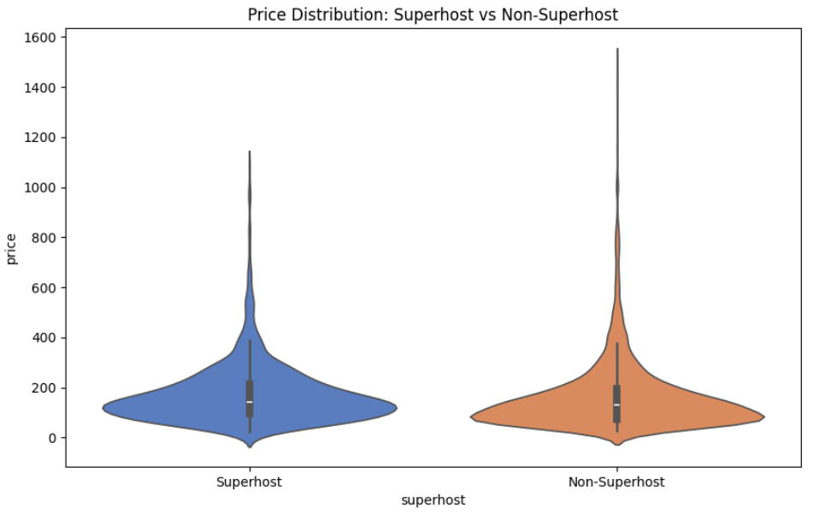
Price Distribution: Superhost Vs NonSuperhost

Slide 17
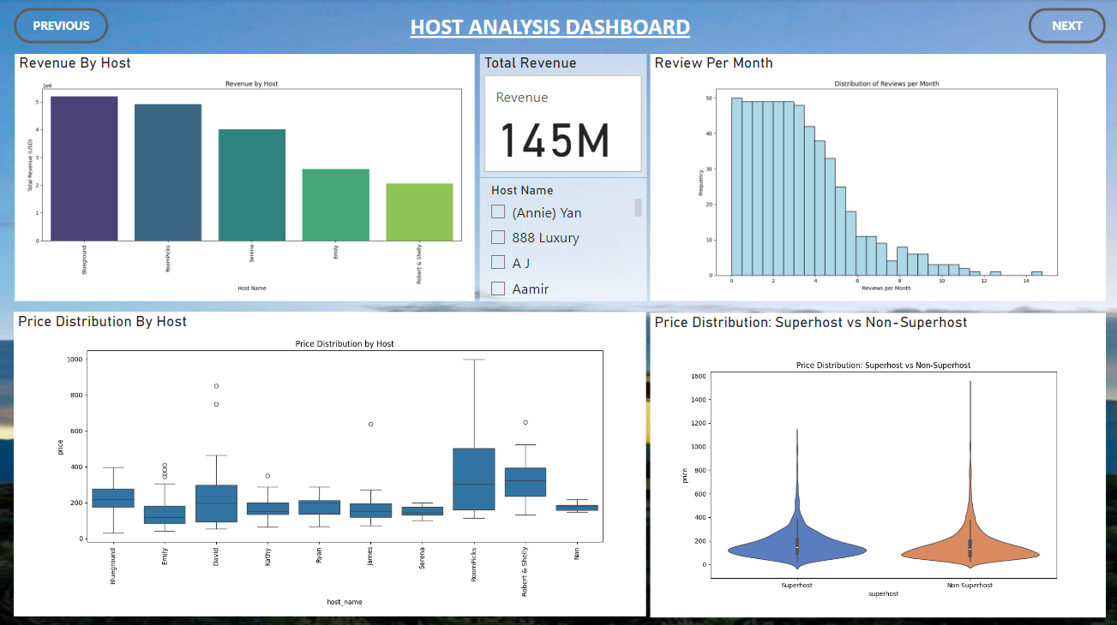
Dashboard

Slide 18
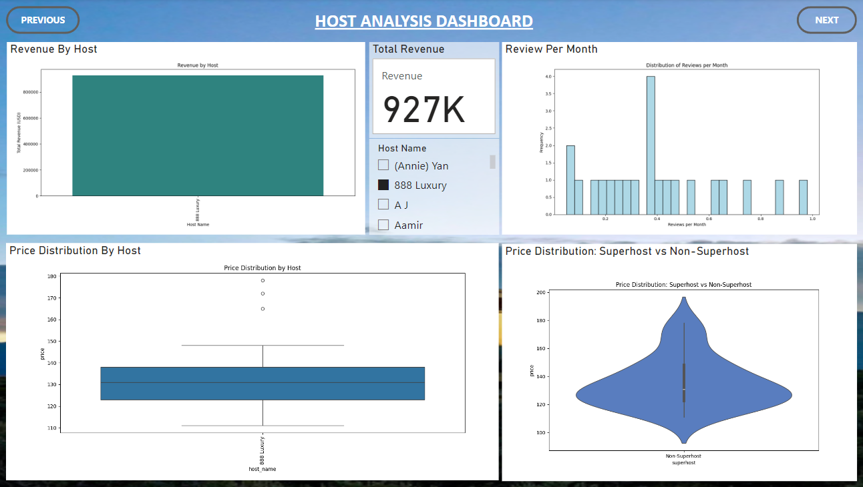
Dashboard

Slide 19
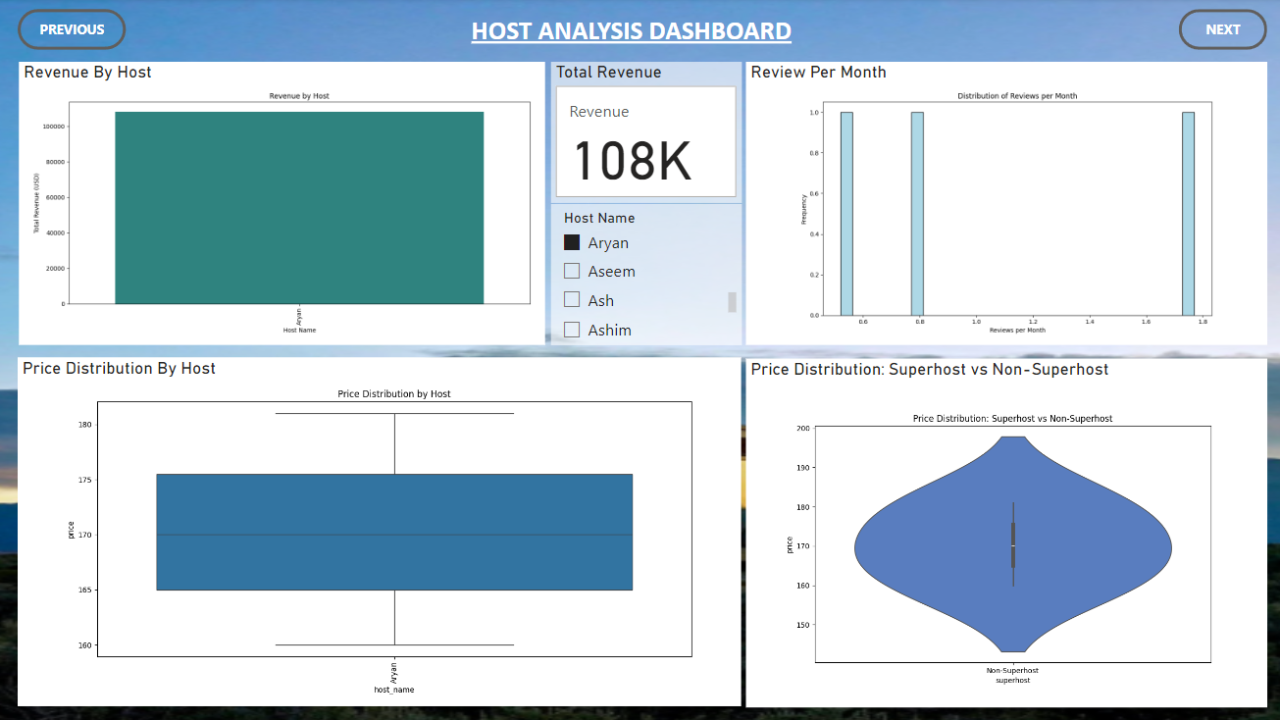
Dashboard

Slide 20
Market Insights

Slide 21
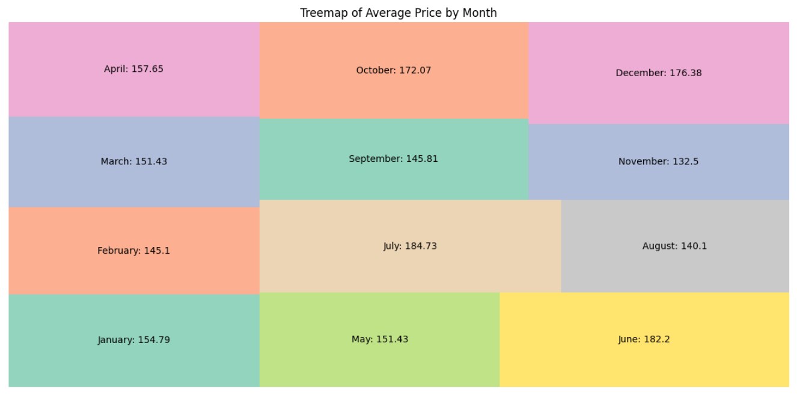
Avg Price Over Time

Slide 22
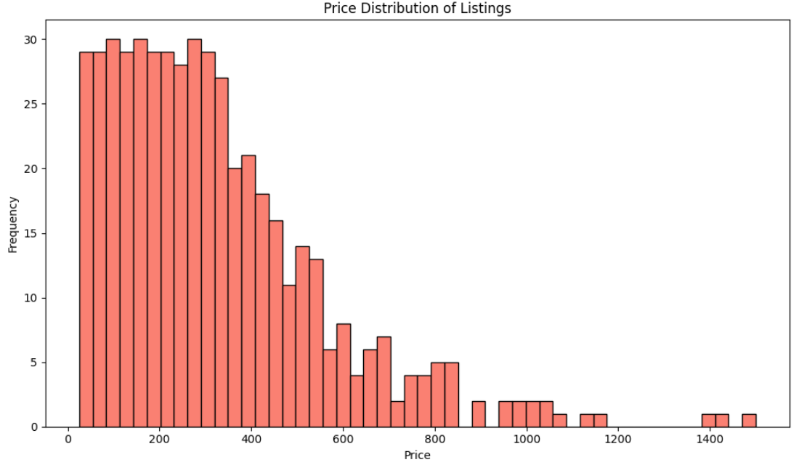
Price Distribution of Listing

Slide 23
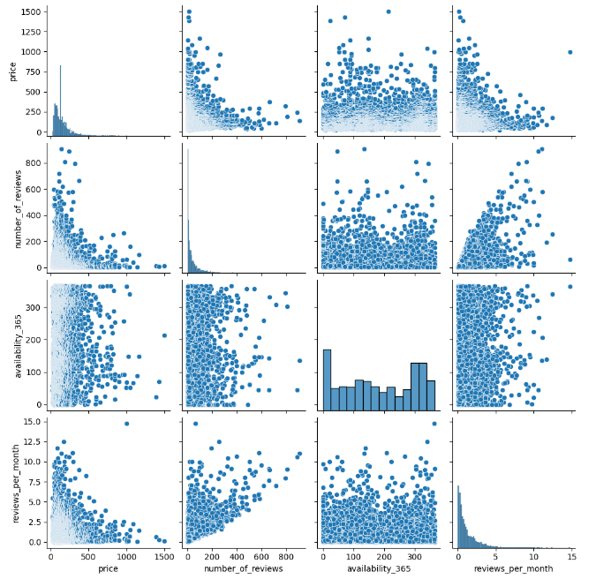
Relationships: Key Numerical Features
Price
No. of Reviews
Availability 365
Reviews per Month

Slide 24
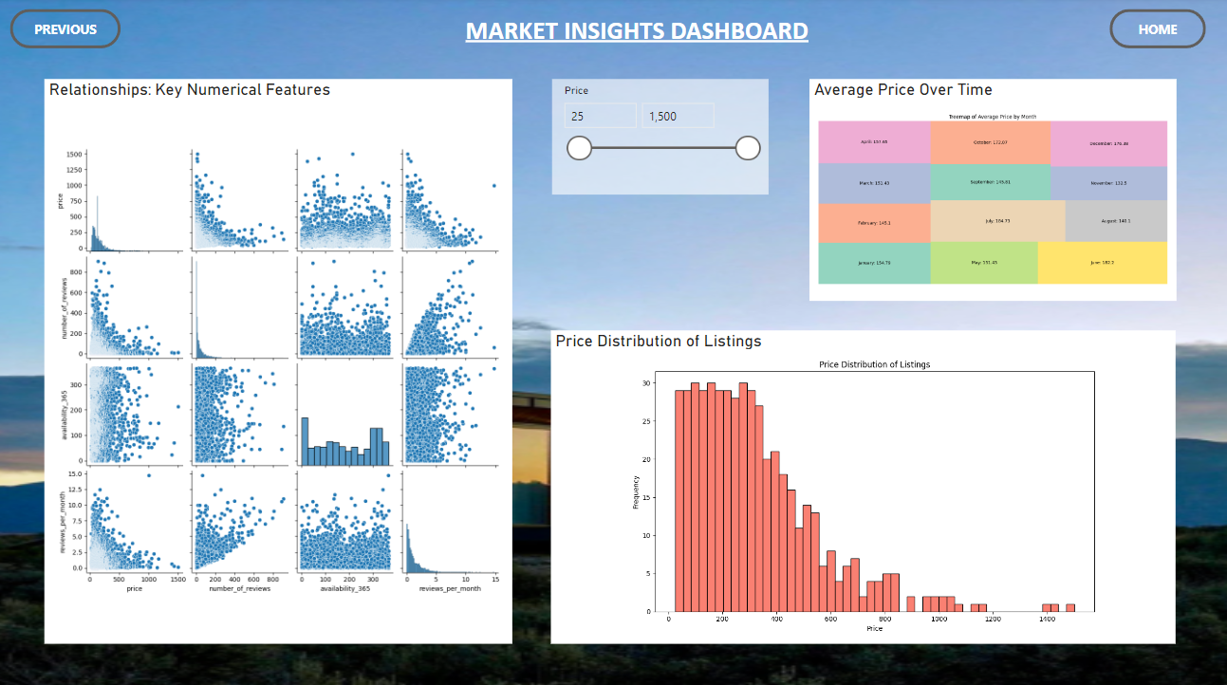
Dashboard

Slide 25
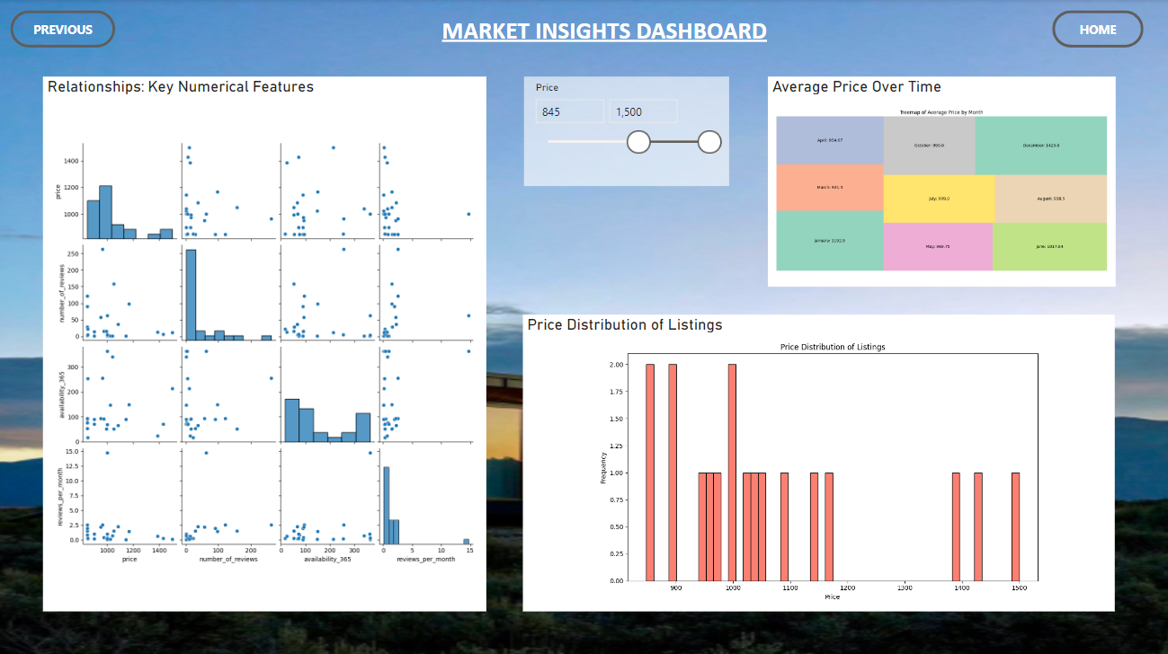
Dashboard

Slide 26
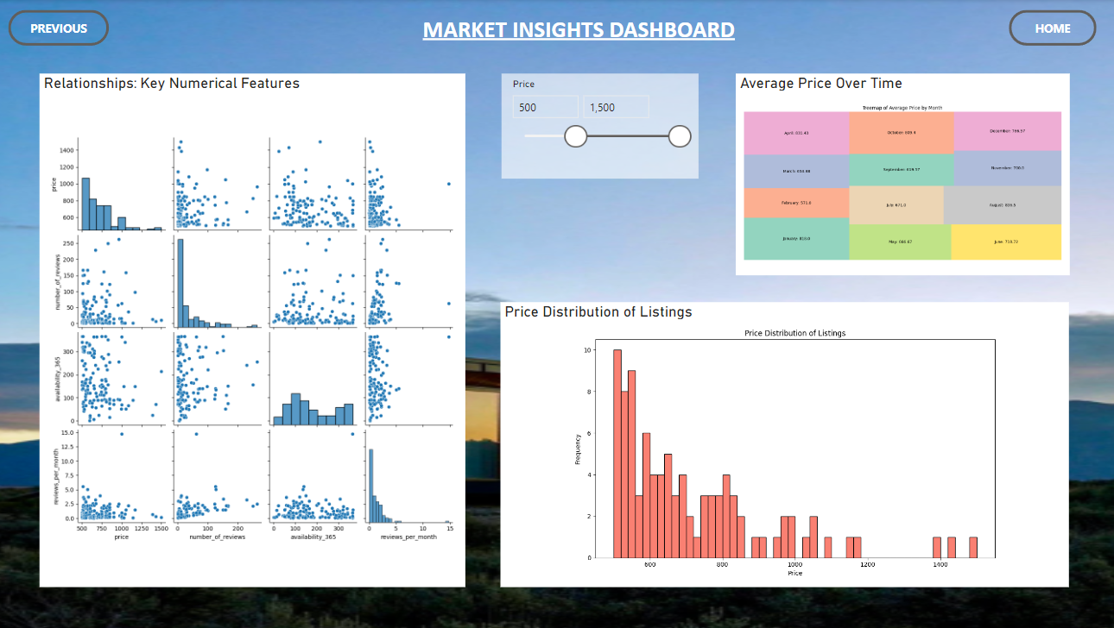
Dashboard

Slide 27
Conclusion
Popular neighborhoods show higher demand and pricing, with Superhosts achieving better occupancy and revenue.
Pricing is influenced by room type, location, and amenities.
Seasonal trends reveal fluctuations in prices and occupancy rates.
Recommendations: Add key amenities in less-popular areas and leverage Superhost status for long-term stays.

Slide 28
Future Scope
Explore traveler preferences using review sentiment analysis.
Analyze the impact of local events on pricing and demand.
Expand the study to neighboring regions and compare trends.
Develop interactive dashboards for real-time market insights.

Slide 29


